Slide 1

TalkToMe An Emotional Detection and Psychological Support Chatbot
Liu Ding - A0231429J
Mediana - A0231458E
Sarah Elita Shi Yuan Wong - A0231507N
Zeng Hanyu - A0231558A

Slide 2




Problem
25%
in anxiety and depression triggered by COVID-19
(World Health Organization, 2022)
50.1%
Not consider seeking professional help and mental health hotlines
(Ministry of Health (MOH) , 2021)
32.8%
consider seeking help from hotline but were unaware of any mental health hotlines
(Ministry of Health (MOH) , 2021)
Notes:
Reason: they could cope by themselves, seek help from friends or family first, too costly and or too busy

Slide 3
Project Objectives
Objectives:
Provide support to people who are feeling down and need comfort via chatting services 24/7
Provide resources / hotlines to user for seeking out professional help
Detect users’ problem and their condition risk level

Slide 4


System Architecture Diagram
Frontend
Backend
Conversation Model (based on BlenderBot)
Dialogue History
Response
Message
Python Controller
User Condition Classification Model
(BiLSTM)
Message
Dialogue History
Reply
Risk Score
Reply
Dialogue History
User
Telegram bot
Category
User Problem Classification Model
(BERT)

Slide 5
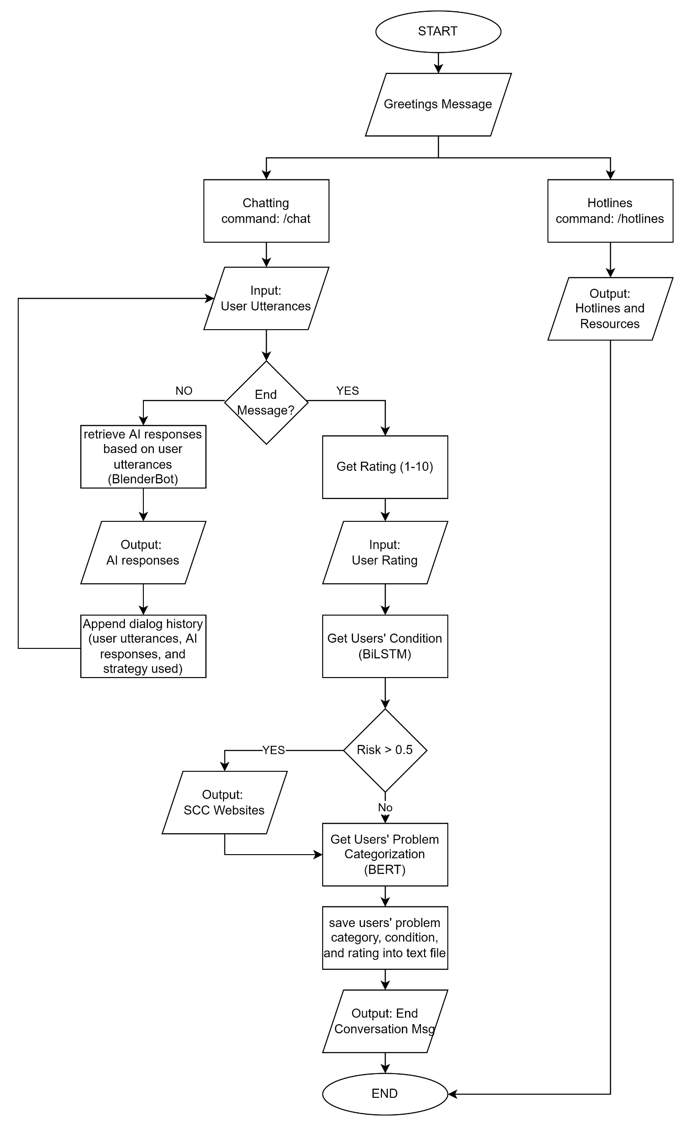
TalkToMe Flowchart

Slide 6
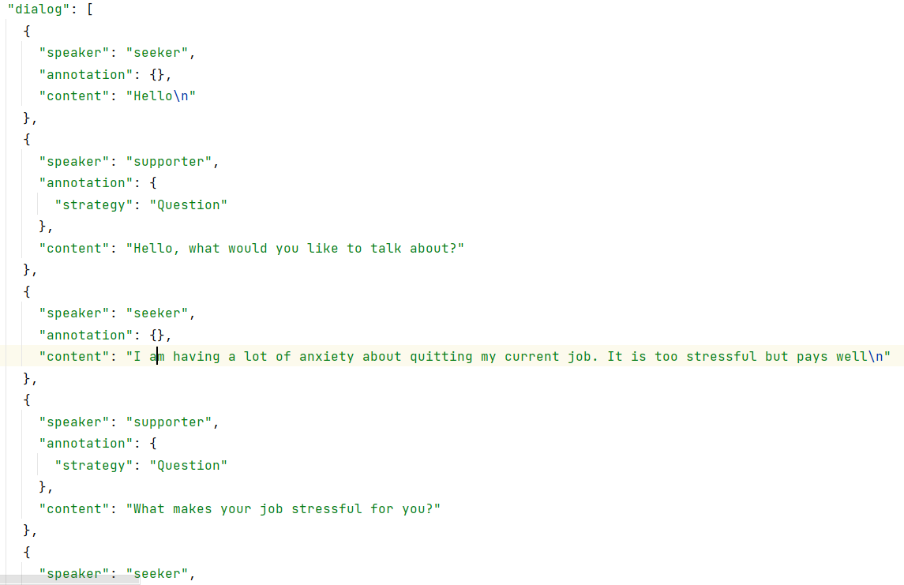
ESConv Dataset for Conversation Model and Users’ Problem Classification Model
Conversation Dialog
Users’ Problem Classification
No | Original Problem Category | Problem Category | Count
1. | Ongoing Depression, Appearance Anxiety | Emotional | 363
2. | Job Crisis | Work | 280
3. | Breakup with Partner | Partner Relationship | 239
4. | Problem with Friends | Friendship | 179
5. | School Bullying, Academic Pressure | School | 158
6. | Conflict with Parents, Issues with Children, Issues with Parents | Family | 28
7. | Sleep problems, Procrastination, Alcohol Abuse | Others | 53
Total |  |  | 1300
Emotional Support Conversation (ESConv) dataset (Liu, Siyang et al, 2021)

Slide 7
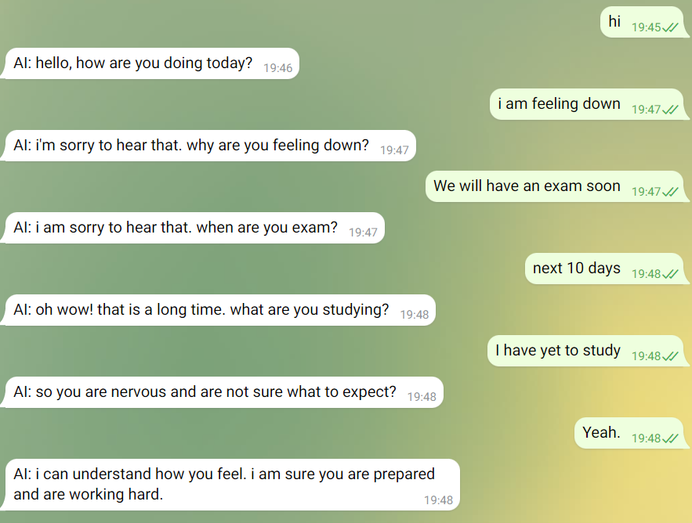
Conversation Model
Function
To be responsible for generating the conversation responses given the user utterances.
Model
a Blender Bot seq2seq model trained on conversations between ‘help-seekers’ and 'supporters'.

Slide 8
Conversation Model
Model
The model has different strategies to generate responses and the strategies are selected based on the current stage of the conversation (i.e., number of turns).
1st-2nd User Utterance (Strategy: Exploration) | 3rd-4th User Utterance (Strategy: Comforting) | >5th User Utterance (Strategy: Action)
Question | Self-disclosure
Restatement or Paraphrasing | Affirmation and Reassurance
- | Reflection of feelings | Information
- | - | Providing Suggestions
- | - | Others
The Strategies Selection

Slide 9
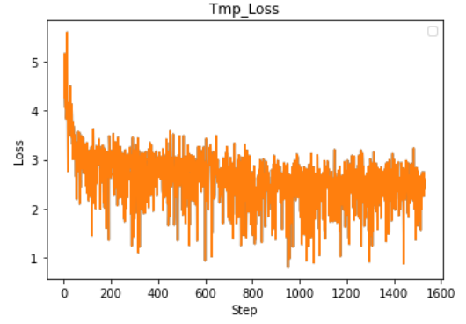
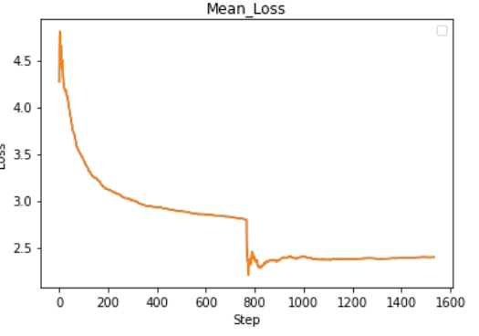
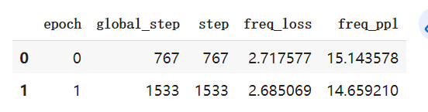
Conversation Model
Evaluation Result
The loss of the model reduced from 5 to 2.5 after training process.
Loss of the model during training
Test loss of the model

Slide 10
User Problem Categorization Model
Function
Multi-classification based on user's dialogue in session (predict user's emotional problem category, divided in "emotional", "work", "relationship", "friendship", "school", "family" and "others".)
Pipeline
Using pre-trained tokenizer from BERT
Input
BERT with:
- 512 embedding dimension
Tokenization
GRU with:
- 2 hidden layers ​
- 0.25 dropout​
- categorical cross entropy ​
- Adam optimizer​
BERT
GRU
Dense(7)
Model Structure
Notes:
Preprocessing: Stopword removal, punctuation removal

Slide 11
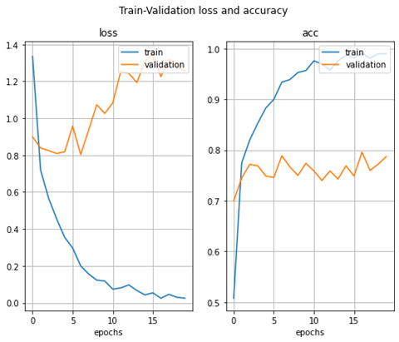
User Problem Categorization Model
BERT Experiment Result
Plotpicture for the model while training
Choose checkpoint with lowest loss at epoch 6 , validation accuracy 78%
and get test accuracy 89.41%

Slide 12
User Problem Categorization Model
Model Experiment Result
We have also tried: CNN, LSTM, BiLSTM, SVM, Random Forest, DT, etc.
No | Model | Test Accuracy
 | BERT with GRU | 89.41%
 | Naïve Bayes | 66%
 | Decision Tree | 68%
 | SVC | 74%
 | Shallow CNN | 59%
 | Shallow CNN with Dropout | 65%
 | Deep CNN | 65%
 | BiLSTM – Recurrent Dropout | 71%
 | Ridge Classifier | 76.4%
 | Random Forest | 72.8%
 | Voting Classifier (RF, RC, SVM) | 76.6%
Notes:
Classic machine learning methods: using CountVectorizer and tfidfTransfomer to build word vec.

Slide 13
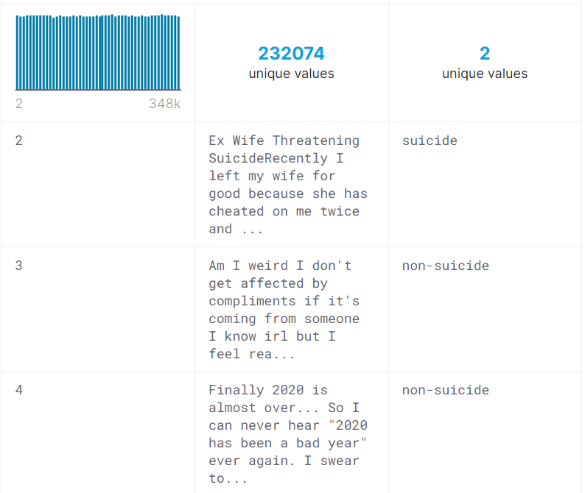
User Condition Model
Function
A binary classification for a user based on the session dialogue (predict high risk/low risk of suicide)
Training Dataset
Suicide detection dataset from Kaggle (by Komati et al.)
Reddit platform posts labelled as "suicide"/"non-suicide"
Limit length to 150 characters -> Reduce to 64368 samples
Data structure inside the Dataset

Slide 14
User Condition Model
Model Structure
an embedding layer, a bidirectional LSTM layer with 64 nodes and a recurrent dropout of 0.5 and a dense output layer with 1 node using sigmoid activation function. Trained using Adam optimizer and binary cross-entropy loss function
Input
BiLSTM(64)
Dropout(0.5)
Dense(1)
Model Structure

Slide 15
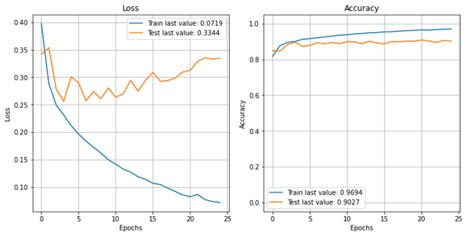
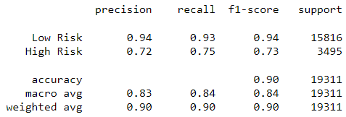
User Condition Model
Experiment Result
the final test accuracy was at 90.1%.
Training accuracy and loss curves
Final model classification report

Slide 16
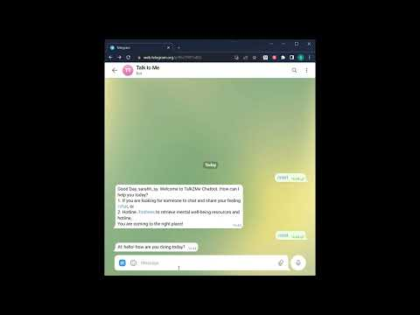
System Demo

Slide 17
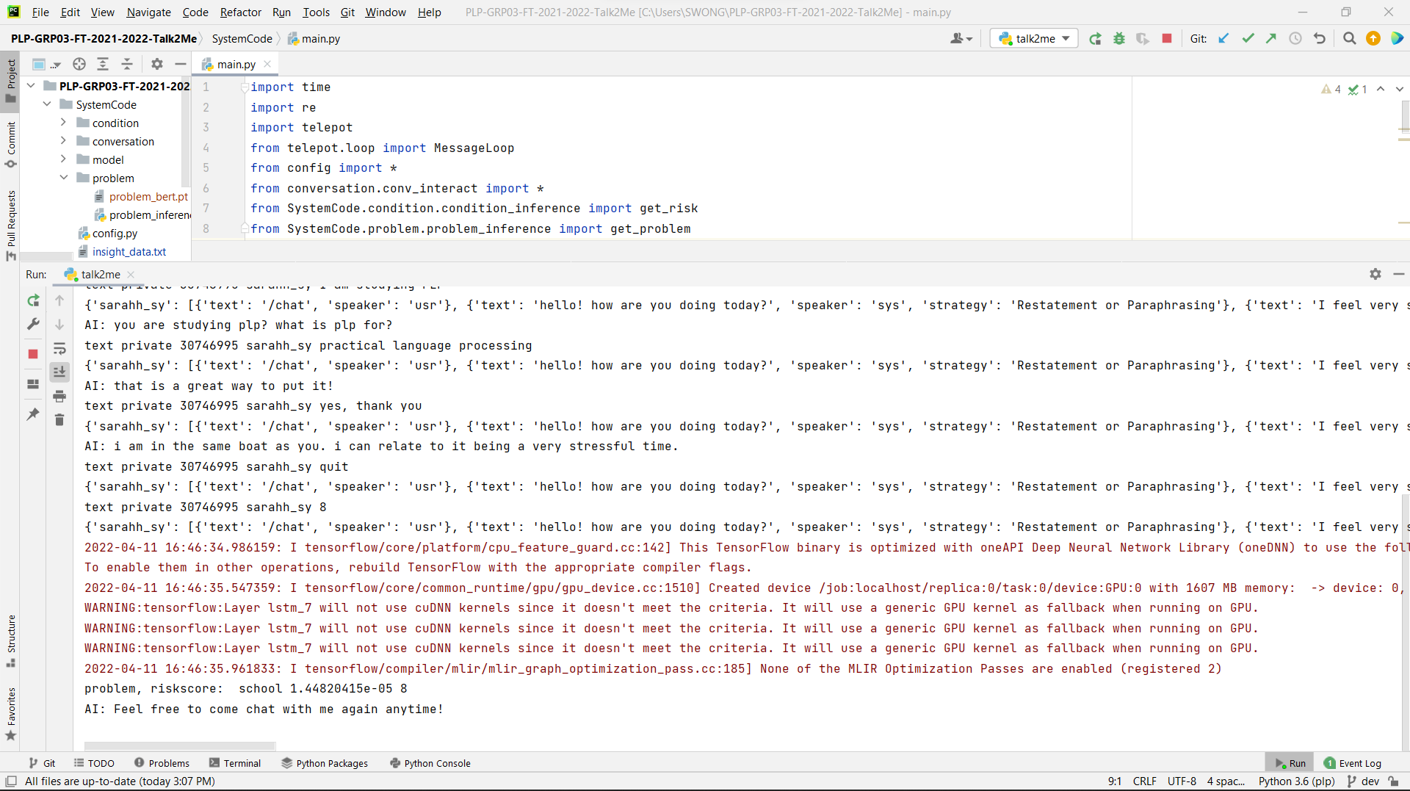

Slide 18
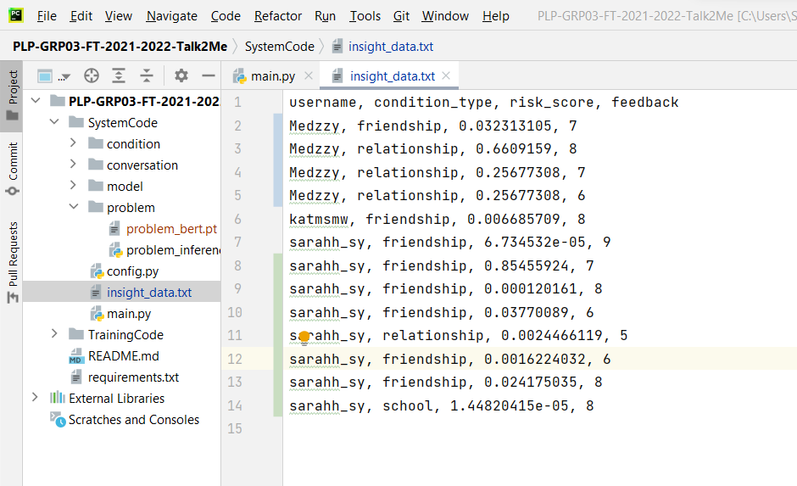

Slide 19
Future Work
Detect emotion type and intensity on-the-fly
Include specific conversation support and hotlines according to users’ problem and their condition
Analyse text summarization of users’ problems and aspect extraction of users’ feedback to improve TalkToMe chatbot
Expand the dataset using chat records between users and the chatbot (after checking data quality)

Slide 20
Thank you
Question and Answer

Slide 21
Appendix

Slide 22
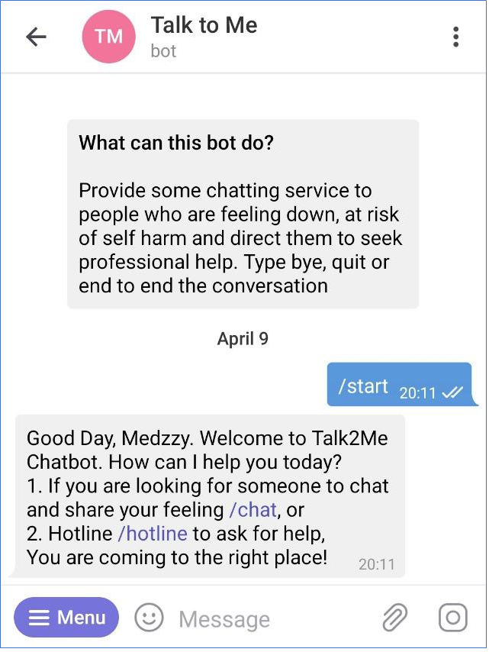
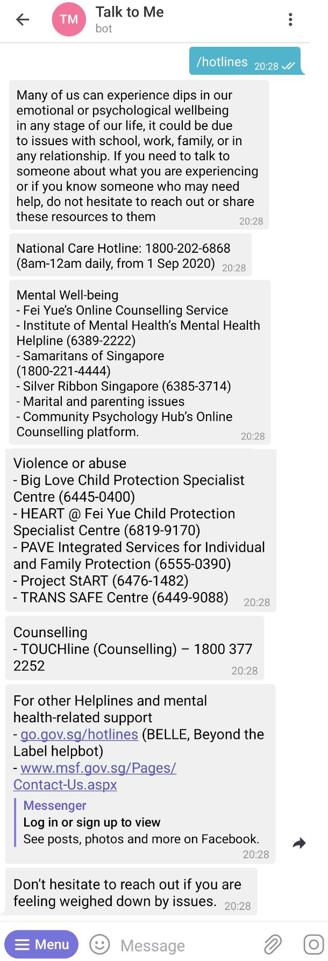
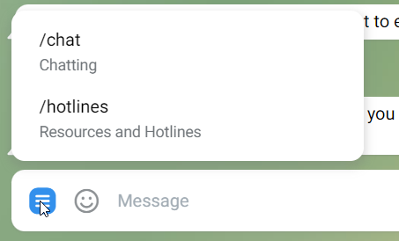
Two Commands/Modes: Chatting and Hotlines Retrieval
TalkToMe Conversation
TalkToMe Introduction and Start Message
TalkToMe Hotlines

Slide 23
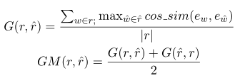

Conversation Model
Evaluation
Four kinds of loss are used in the evaluation part,
1.Greedy Match:
By using average value of the similarity between the most similar word tokens between generated response and the ground truth in the sentence.
2.Embedding Average:
By using the similarity between the average value of the word vector.
3.Vector Extrema:
By using the similarity between the extreme value of the word vector.
4.BLEU:
By calculating the possibility that the n-grams of ground truth appear in the generated response.
Greedy Match
Embedding Average

